Slide 1




AngularJS Services
Built-in and Custom Services
SoftUni Team
Technical Trainers
Software University
http://softuni.bg

Slide 2

Table of Contents
What is a AngularJS Service?
Why Should You Use Services?
Built-In Services
Creating Custom Services

Slide 3

What is AngularJS Service?
Reusable Components Holding App Logic

Slide 4

What is AngularJS Service?
A worker object that performs some sort of logic
Not necessarily over-the-wire
Often stateless
Lazily instantiated
Singletons
Built-in services always start with $
E.g. $http, $location, $log, $q, $animate, …

Slide 5
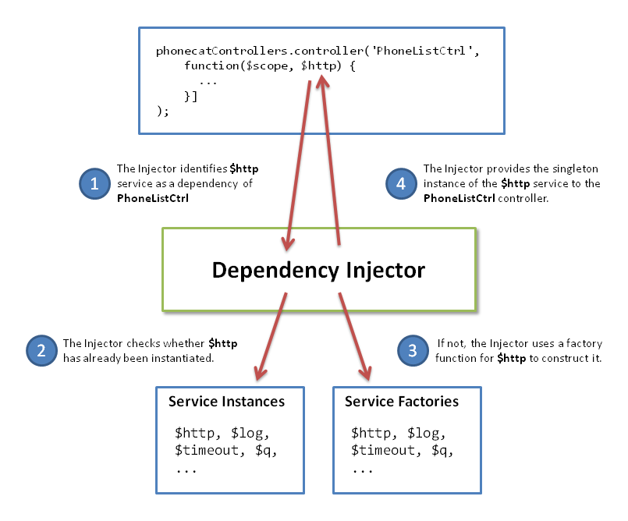
Why Use Services?
Reusability
Services encapsulate reusable business logic
Dependency Injection
Inject services into controllers / other services
Single Responsibility Principle
Better encapsulation
Testable

Slide 6


Built-In Angular Services
$http, $resource, $location, $q, …

Slide 7
Built-In Angular Services
$http – communication with remote servers via HTTP
$resource – RESTfull server-side data sources interaction
$location – navigation between pages in the app
$route / $routeParams – map URL to routes
$q – promise library for asynchronous execution
$exceptionHandler – handles uncaught exceptions
$anchorScroll – scrolls to the related element

Slide 8
Built-In Angular Services (2)
$cacheFactory – cache functionality
$compile – compiles an HTML string or DOM
$parse – converts AngularJS expression into a function
$locale – localization rules for various Angular components
$timeout – timeout with compiling (like setTimeout)
$filter – formatting data displayed to the user
$cookieStore – cookies wrapper

Slide 9
Other Built-In Angular Services
$interpolate
$log
$rootScope
$window
$document
$rootElement
$httpBackend
$controller

Slide 10
Built-In Angular Services
Live Demo

Slide 11

Creating Custom Services
Defining Reusable Services in Angular

Slide 12
Creating Custom Angular Service
myApp.factory('data', function data() {
return {
getVideos: getAllVideos,
addVideo: addVideo,
}
});
myApp.controller('VideosController',
function VideosController($scope, data) {
data.getVideos();
});

Slide 13
Creating Custom Services
Live Demo

Slide 14


Summary
Which would be the best way to access a RESTFul web service?
Using $resource service
Which service would you use to localize date-time?
$locale
Can child scopes access items on the root scope?
Yes, due to prototypal inheritance
SPA with AngularJS

Slide 15









AngularJS Services
https://softuni.bg/courses/spa-applications-angularjs

Slide 16
License
This course (slides, examples, demos, videos, homework, etc.) is licensed under the "Creative Commons Attribution-NonCommercial-ShareAlike 4.0 International" license
Attribution: this work may contain portions from
"SPA with AngularJS" course by Telerik Academy under CC-BY-NC-SA license

Slide 17





Free Trainings @ Software University
Software University Foundation – softuni.org
Software University – High-Quality Education, Profession and Job for Software Developers
softuni.bg
Software University @ Facebook
facebook.com/SoftwareUniversity
Software University @ YouTube
youtube.com/SoftwareUniversity
Software University Forums – forum.softuni.bg

